Slide 1
.NET/C# Training
Parthiban
20/11/2023
Notes:
This template can be used as a starter file for presenting training materials in a group setting.
Sections
Right-click on a slide to add sections. Sections can help to organize your slides or facilitate collaboration between multiple authors.
Notes
Use the Notes section for delivery notes or to provide additional details for the audience. View these notes in Presentation View during your presentation.
Keep in mind the font size (important for accessibility, visibility, videotaping, and online production)
Coordinated colors
Pay particular attention to the graphs, charts, and text boxes.
Consider that attendees will print in black and white or grayscale. Run a test print to make sure your colors work when printed in pure black and white and grayscale.
Graphics, tables, and graphs
Keep it simple: If possible, use consistent, non-distracting styles and colors.
Label all graphs and tables.

Slide 2
C# generics
C# Generics allow us to create a single class or method that can be used with different types of data. This helps us to reuse our code.
class Student<T>
{
// block of code
}
T used inside the angle bracket is called the type parameter.
// create an instance with data type string
Student<string> studentName = new Student<string>();
Notes:
Give a brief overview of the presentation. Describe the major focus of the presentation and why it is important.
Introduce each of the major topics.
To provide a road map for the audience, you can repeat this Overview slide throughout the presentation, highlighting the particular topic you will discuss next.

Slide 3
public class Student<T>
{
// define a variable of type T
public T data;
// define a constructor of the Student class
public Student(T data)
{
this.data = data;
Console.WriteLine("Data passed: " + this.data);
}
}
// create an instance with data type string
Student<string> studentName = new Student<string>("Avicii");
// create an instance with data type int
Student<int> studentId = new Student<int>(23);

Slide 4
class Employee<T>
{
// define a generics method that displays the passed data
public void displayData(T data)
{
Console.WriteLine("The data passed is: " + data);
}
}
// create an instance of Employee class by specifying T as string
Employee<string> employeeName = new Employee<string>();
// call displayData() generics method and pass a string value - "Jack"
employeeName.displayData("Jack");
// create an instance of Employee class by specifying T as int
Employee<int> employeeId = new Employee<int>();
// call displayData() generics method and pass an integer value
employeeId.displayData(123);

Slide 5
using System;
// define a generics class named Employee
class Movie<T>
{
// define a generics method that returns T type value
public T displayData(T data)
{
return data;
}
static void Main()
{
// create an instance with data type string
Movie<string> movieName = new Movie<string>();
Console.WriteLine("Generics Method returns: " + movieName.displayData("Inception"));
// create an instance with data type int
Movie<int> movieRating = new Movie<int>();
Console.WriteLine("Generics Method returns: " + movieRating.displayData(9));
}

Slide 6
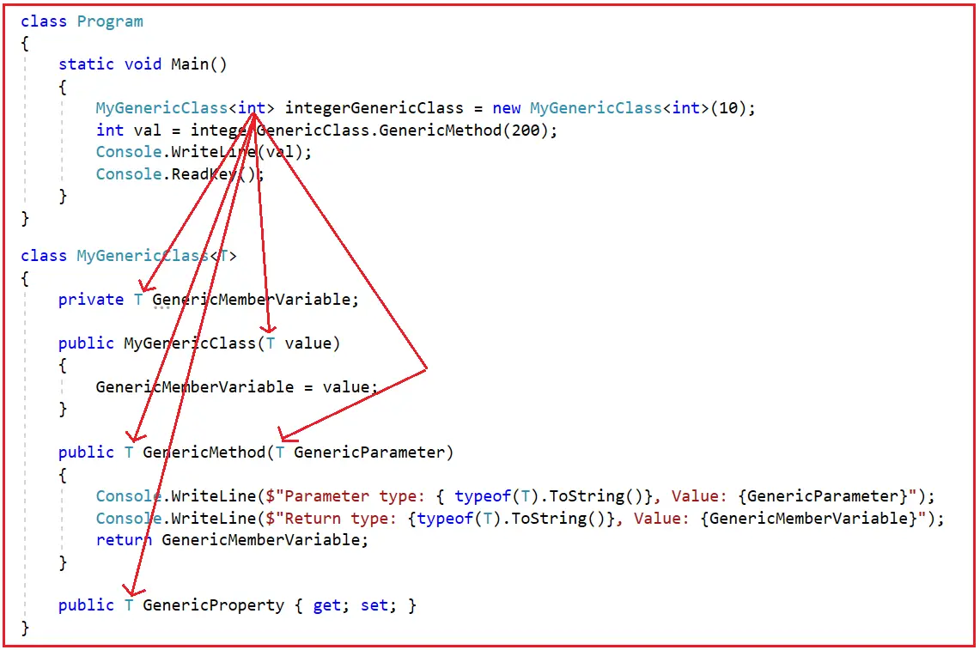

Slide 7
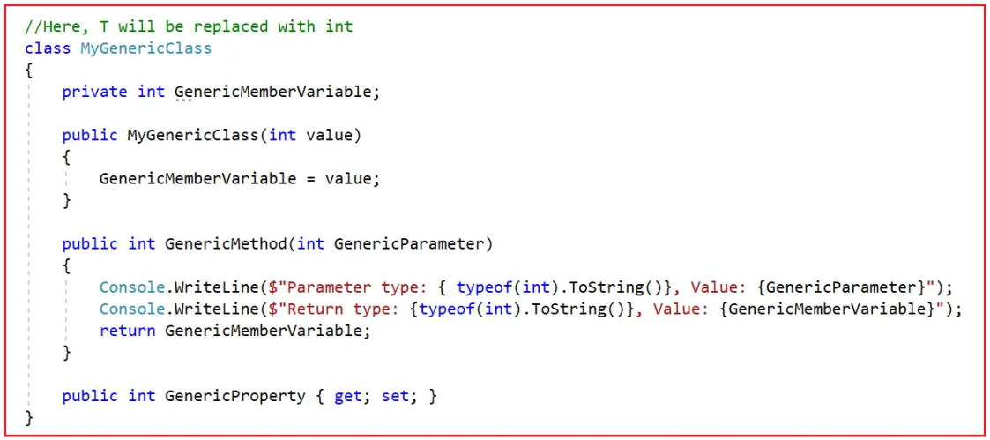

Slide 8
public class SomeClass
{
//Making the Method as Generic by using the <T1, T2>
//Then using T1 and T2 as parameters of the method
public void GenericMethod<T1, T2>(T1 Param1, T2 Param2)
{
Console.WriteLine($"Parameter T1 type: {typeof(T1)}: Parameter T2 type: {typeof(T2)}");
Console.WriteLine($"Parameter 1: {Param1} : Parameter 2: {Param2}");
}
}
class Program
{
static void Main(string[] args)
{
Console.WriteLine("Generic Method Example in C#");
SomeClass s = new SomeClass();
//While calling the method we need to specify the type for both T1 and T2
s.GenericMethod<int, int>(10, 20);
s.GenericMethod<double, string>(10.5, "Hello");
s.GenericMethod<string, float>("Anurag", 20.5f);
Console.ReadLine();
}
}

Slide 9
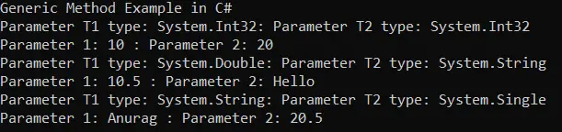

Slide 10
C# - List<T>
The List<T> is a collection of strongly typed objects that can be accessed by index and having methods for sorting, searching, and modifying list. It is the generic version of the ArrayList that comes under System.Collections.Generic namespace.
List<T> is a generic collection,

Slide 11
List<int> primeNumbers = new List<int>();
primeNumbers.Add(1); // adding elements using add() method
primeNumbers.Add(3);
primeNumbers.Add(5);
primeNumbers.Add(7);
var cities = new List<string>();
cities.Add("New York");
cities.Add("London");
cities.Add("Mumbai");
cities.Add("Chicago");
cities.Add(null);// nulls are allowed for reference type list
//adding elements using collection-initializer syntax
var bigCities = new List<string>()
{
"New York",
"London",
"Mumbai",
"Chicago"
};

Slide 12
var students = new List<Student>() {
new Student(){ Id = 1, Name="Bill"},
new Student(){ Id = 2, Name="Steve"},
new Student(){ Id = 3, Name="Ram"},
new Student(){ Id = 4, Name="Abdul"}
};
List<int> primeNumbers = new List<int>();
primeNumbers.Add(1); // adding elements using add() method
primeNumbers.Add(3);
primeNumbers.Add(5);
primeNumbers.Add(7);
var cities = new List<string>();
cities.Add("New York");
cities.Add("London");
cities.Add("Mumbai");
cities.Add("Chicago");
cities.Add(null);// nulls are allowed for reference type list
//adding elements using collection-initializer syntax
var bigCities = new List<string>()
{
"New York",
"London",
"Mumbai",
"Chicago"
};

Slide 13
C# - SortedList<TKey, TValue>
//SortedList of int keys, string values
SortedList<int, string> numberNames = new SortedList<int, string>();
numberNames.Add(3, "Three");
numberNames.Add(1, "One");
numberNames.Add(2, "Two");
numberNames.Add(4, null);
numberNames.Add(10, "Ten");
numberNames.Add(5, "Five");
SortedList<string,string> cities = new SortedList<string,string>()
{
{"London", "UK"},
{"New York", "USA"},
{ "Mumbai", "India"},
{"Johannesburg", "South Africa"}
};

Slide 14
SortedList<int,string> numberNames = new SortedList<int,string>()
{
{3, "Three"},
{5, "Five"},
{1, "One"}
};
Console.WriteLine("---Initial key-values--");
foreach(KeyValuePair<int, string> kvp in numberNames)
Console.WriteLine("key: {0}, value: {1}", kvp.Key , kvp.Value );
numberNames.Add(6, "Six");
numberNames.Add(2, "Two");
numberNames.Add(4, "Four");
Console.WriteLine("---After adding new key-values--");
foreach(var kvp in numberNames)
Console.WriteLine("key: {0}, value: {1}", kvp.Key , kvp.Value );

Slide 15
SortedList<int,string> numberNames = new SortedList<int,string>()
{
{3, "Three"},
{1, "One"},
{2, "Two"}
};
Console.WriteLine(numberNames[1]); //output: One
Console.WriteLine(numberNames[2]); //output: Two
Console.WriteLine(numberNames[3]); //output: Three
//Console.WriteLine(numberNames[10]); //run-time KeyNotFoundException
numberNames[2] = "TWO"; //updates value
numberNames[4] = "Four"; //adds a new key-value if a key does not exists

Slide 16
C# - Dictionary<TKey, TValue>
IDictionary<int, string> numberNames = new Dictionary<int, string>();
numberNames.Add(1,"One"); //adding a key/value using the Add() method
numberNames.Add(2,"Two");
numberNames.Add(3,"Three");
//The following throws run-time exception: key already added.
//numberNames.Add(3, "Three");
foreach(KeyValuePair<int, string> kvp in numberNames)
Console.WriteLine("Key: {0}, Value: {1}", kvp.Key, kvp.Value);
//creating a dictionary using collection-initializer syntax
var cities = new Dictionary<string, string>(){
{"UK", "London, Manchester, Birmingham"},
{"USA", "Chicago, New York, Washington"},
{"India", "Mumbai, New Delhi, Pune"}
};
foreach(var kvp in cities)
Console.WriteLine("Key: {0}, Value: {1}", kvp.Key, kvp.Value);

Slide 17
var cities = new Dictionary<string, string>(){
{"UK", "London, Manchester, Birmingham"},
{"USA", "Chicago, New York, Washington"},
{"India", "Mumbai, New Delhi, Pune"}
};
Console.WriteLine(cities["UK"]); //prints value of UK key
Console.WriteLine(cities["USA"]);//prints value of USA key
//Console.WriteLine(cities["France"]); // run-time exception: Key does not exist
//use ContainsKey() to check for an unknown key
if(cities.ContainsKey("France")){
Console.WriteLine(cities["France"]);
}

Slide 18
C# - Hashtable
Dictionary<TKey, TValue>
Hashtable numberNames = new Hashtable();
numberNames.Add(1,"One"); //adding a key/value using the Add() method
numberNames.Add(2,"Two");
numberNames.Add(3,"Three");
//The following throws run-time exception: key already added.
//numberNames.Add(3, "Three");
foreach(DictionaryEntry de in numberNames)
Console.WriteLine("Key: {0}, Value: {1}", de.Key, de.Value);
//creating a Hashtable using collection-initializer syntax
var cities = new Hashtable(){
{"UK", "London, Manchester, Birmingham"},
{"USA", "Chicago, New York, Washington"},
{"India", "Mumbai, New Delhi, Pune"}
};
foreach(DictionaryEntry de in cities)
Console.WriteLine("Key: {0}, Value: {1}", de.Key, de.Value);

Slide 19
C# - Stack<T>
Stack<int> myStack = new Stack<int>();
myStack.Push(1);
myStack.Push(2);
myStack.Push(3);
myStack.Push(4);
foreach (var item in myStack)
Console.Write(item + ","); //prints 4,3,2,1,

Slide 20
C# - Queue<T>
Queue<int> callerIds = new Queue<int>();
callerIds.Enqueue(1);
callerIds.Enqueue(2);
callerIds.Enqueue(3);
callerIds.Enqueue(4);
foreach(var id in callerIds)
Console.Write(id); //prints 1234

Slide 22
C# Stack Properties
Property | Description
Count | It will return the total number of elements in a stack.
IsSynchronized | It is used to get a value to indicate whether access to the stack is synchronized (thread-safe) or not.

Slide 23
C# Stack Methods
Method | Description
Push | It is used to insert an object at the top of a stack.
Pop | It will remove and return an object at the top of the stack.
Clear | It will remove all the elements from the stack.
Clone | It will create a shallow copy of the stack.
Contains | It is used to determine whether an element exists in a stack or not.
Peek | It is used to return a top element from the stack.

Slide 24
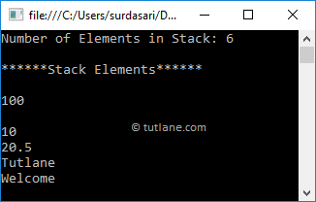
Stack stk = new Stack();
stk.Push("Welcome");
stk.Push("Tutlane");
stk.Push(20.5f);
stk.Push(10);
stk.Push(null);
stk.Push(100);
Console.WriteLine("Number of Elements in Stack: {0}", stk.Count);
Console.WriteLine("******Stack Elements******");
// Access Stack Elements
foreach (var item in stk)
{
Console.WriteLine(item);
}
Console.ReadLine();

Slide 25
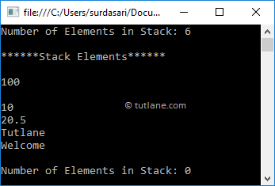
Stack stk = new Stack();
stk.Push("Welcome");
stk.Push("Tutlane");
stk.Push(20.5f);
stk.Push(10);
stk.Push(null);
stk.Push(100);
Console.WriteLine("Number of Elements in Stack: {0}", stk.Count);
Console.WriteLine("******Stack Elements******");
// Access Stack Elements
while (stk.Count > 0)
{
Console.WriteLine(stk.Pop());
}

Slide 26
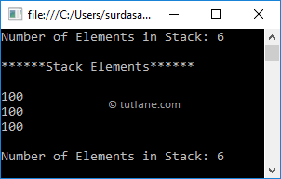
// Create and initialize a stack
Stack stk = new Stack();
stk.Push("Welcome");
stk.Push("Tutlane");
stk.Push(20.5f);
stk.Push(10);
stk.Push(null);
stk.Push(100);
Console.WriteLine("Number of Elements in Stack: {0}", stk.Count);
Console.WriteLine("******Stack Elements******");
// Access Stack Elements
Console.WriteLine(stk.Peek());
Console.WriteLine(stk.Peek());
Console.WriteLine(stk.Peek());
Console.WriteLine("Number of Elements in Stack: {0}", stk.Count);
Console.ReadLine();

Slide 27
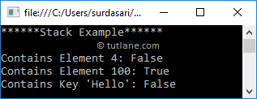
Stack stk = new Stack();
stk.Push("Welcome");
stk.Push("Tutlane");
stk.Push(20.5f);
stk.Push(10);
stk.Push(null);
stk.Push(100);
Console.WriteLine("******Stack Example******");
Console.WriteLine("Contains Element 4: {0}", stk.Contains(4));
Console.WriteLine("Contains Element 100: {0}", stk.Contains(100));
Console.WriteLine("Contains Key 'Hello': {0}", stk.Contains("Hello"));

Slide 28
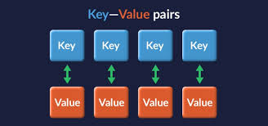
C# HashTable
store a key/value pair elements of different data type
Hashtable htbl = new Hashtable();
Key | Value
code | 101
Train | Vaigai
State | TN
Country | India

Slide 29
Property | Description
Count | It is used to get the number of key/value pair elements in the hashtable.
IsFixedSize | It is used to get a value to indicate whether the hashtable has a fixed size or not.
IsReadOnly | It is used to get a value to indicate whether the hashtable is read-only or not.
Item | It is used to get or set the value associated with the specified key.
IsSynchronized | It is used to get a value to indicate whether access to the hashtable is synchronized (thread-safe) or not.
Keys | It is used to get the collection of keys in the hashtable.
Values | It is used to get the collection of values in the hashtabl

Slide 30
Method | Description
Add | It is used to add an element with a specified key and value in a hashtable.
Clear | It will remove all the elements from the hashtable.
Clone | It will create a shallow copy of the hashtable.
Contains | It is useful to determine whether the hashtable contains a specific key or not.
ContainsKey | It is useful to determine whether the hashtable contains a specific key or not.
ContainsValue | It is useful to determine whether the hashtable contains a specific value or not.
Remove | It is useful to remove an element with a specified key from the hashtable.
GetHash | It is useful to get the hash code for the specified key.

Slide 31
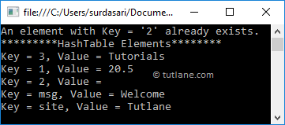
Hashtable htbl = new Hashtable(); htbl.Add("msg", "Welcome"); htbl.Add("site", "Tutlane"); htbl.Add(1, 20.5); htbl.Add(2, null); // Another way to add elements. If the key does not exist, then that key adds a new key/value pair. htbl[3] = "Tutorials";
foreach (DictionaryEntry item in htbl) { Console.WriteLine("Key = {0}, Value = {1}", item.Key, item.Value); }

Slide 32
Hashtable htbl = new Hashtable(){
{"msg", "Welcome"},
{"site", "Tutlane"},
{1, 20.5},
{2, null}
};

Slide 33
Hashtable htbl = new Hashtable();
htbl.Add("msg", "Welcome");
htbl.Add("site", "Tutlane");
htbl.Add(1, 20.5f);
htbl.Add(2, 10);
string msg = (string)htbl["msg"];
float num = (float)htbl[1];
Console.WriteLine("*********Access Elements with Keys********");
Console.WriteLine("Value at Key 'msg': " + msg);
Console.WriteLine("Value at Key '1': " + num);
Console.WriteLine("*********Access Elements with Foreach Loop********");
foreach (DictionaryEntry item in htbl)
{
Console.WriteLine("Key = {0}, Value = {1}", item.Key, item.Value);
}
Console.WriteLine("*********HashTable Keys********");
foreach (var item in htbl.Keys)
{
Console.WriteLine("Key = {0}", item);
}
Console.WriteLine("*********HashTable Values********");
foreach (var item in htbl.Values)
{
Console.WriteLine("Value = {0}", item);
}
Console.ReadLine();

Slide 34
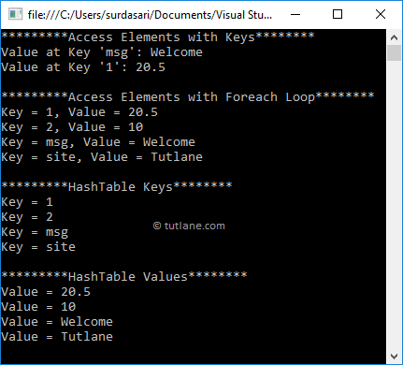

Slide 35
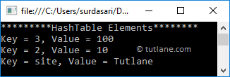
Hashtable htbl = new Hashtable();
htbl.Add("msg", "Welcome");
htbl.Add("site", "Tutlane");
htbl.Add(1, 20.5f);
htbl.Add(2, 10);
htbl.Add(3, 100);
// Removing hashtable elements with keys
htbl.Remove(1);
htbl.Remove("msg");
Console.WriteLine("*********HashTable Elements********");
foreach (DictionaryEntry item in htbl)
{
Console.WriteLine("Key = {0}, Value = {1}", item.Key, item.Value);
}

Slide 36
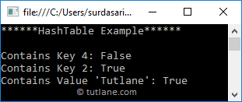
Hashtable htbl = new Hashtable();
htbl.Add("msg", "Welcome");
htbl.Add("site", "Tutlane");
htbl.Add(1, 20.5f);
htbl.Add(2, 10);
htbl.Add(3, 100);
Console.WriteLine("Contains Key 4: {0}", htbl.Contains(4));
Console.WriteLine("Contains Key 2: {0}", htbl.ContainsKey(2));
Console.WriteLine("Contains Value 'Tutlane': {0}", htbl.ContainsValue("Tutlane"));

Slide 37
SortedList
What is SortedList in C#?
The Non-Generic SortedList Collection Class in C# represents a collection of key/value pairs that are sorted by the keys and are accessible by key and by index. By default, it sorts the key/value pairs in ascending order.
SortedList sortedList = new SortedList();

Slide 38
SortedList sortedList = new SortedList();
sortedList.Add(1, “One”);
sortedList.Add(3, “Three”);
SortedList sortedList = new SortedList
{
{ 1, “One” },
{ 3, “Three” }
};
Console.WriteLine($”Key: 1, Value: {sortedList[1]}”);
Console.WriteLine($”Key: 2, Value: {sortedList[2]}”);
Console.WriteLine($”Key: 3, Value: {sortedList[3]}”);
Console.WriteLine($”Key: 1, Index: 0, Value: {sortedList.GetByIndex(0)}”);
Console.WriteLine($”Key: 2, Index: 1, Value: {sortedList.GetByIndex(1)}”);
Console.WriteLine($”Key: 3, Index: 2, Value: {sortedList.GetByIndex(2)}”);

Slide 39
for (int x = 0; x < sortedList.Count; x++)
{
Console.WriteLine($”Key: {sortedList.GetKey(x)}, Value: {sortedList.GetByIndex(x)}”);
}
foreach (DictionaryEntry item in sortedList)
{
Console.WriteLine($”Key: {item.Key}, Value: {item.Value}”);
}

Slide 40
//Creating sortedList Collection
SortedList sortedList = new SortedList();
//Adding Elements to SortedList using Add Method
//Key type going to be same
sortedList.Add(1, "One");
sortedList.Add(5, "Five");
sortedList.Add(4, "Four");
sortedList.Add(2, "Two");
sortedList.Add(3, "Three");
Console.WriteLine("Accessing SortedList using For loop");
for (int x = 0; x < sortedList.Count; x++)
{
Console.WriteLine($"Key: {sortedList.GetKey(x)}, Value: {sortedList.GetByIndex(x)}");
}
Console.WriteLine("\nAccessing SortedList using For Each loop");
//Accessing SortedList using For Each loop
foreach (DictionaryEntry item in sortedList)
{
Console.WriteLine($"Key: {item.Key}, Value: {item.Value}");
}

Slide 48
MiddleWare
DB
UI
.NET/MiddleWare
DB
UI

